Slide 1
ALY 6040 Final Project Car Price Prediction
By:
Ayush Patel Mihir Dharaiya Mridulla Ganesh Nithin Reddy Penta Reddy Anusha Reddy
Presented to : Dr. Harpreet Sharma Date: 14/05/24

Slide 2

Dataset Selection Rationale
Comprehensive dataset of 16,000+ Australian car listings for 2023, offering insights into pricing factors and market trends.
Analytical Potential: Rich dataset enabling in-depth analysis of car pricing drivers and market dynamics.
Actionable Insights: Derive strategic insights to optimize pricing strategies and enhance market competitiveness.

Slide 3
Business Question and Techniques
Objective: To understand the primary factors influencing car prices in the Australian market and accurately predict these prices using machine learning algorithms.
Methodology:
Perform exploratory data analysis (EDA) on the dataset to uncover insights into pricing determinants.
Utilize machine learning algorithms:
Linear Regression
Ridge and Lasso Regression
Decision Trees
Random Forest Regression
Support Vector Machine (SVM)
Train and evaluate models to predict car prices based on various factors mentioned in the dataset.
Outcome: Accurate predictions of car prices in the Australian market, enabling stakeholders to optimize pricing strategies and improve competitiveness.

Slide 4
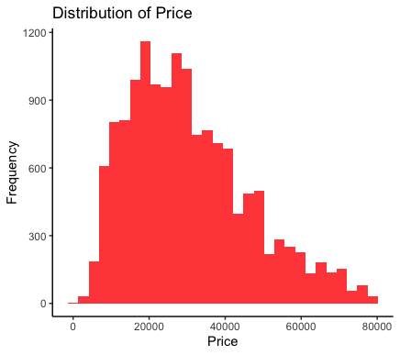
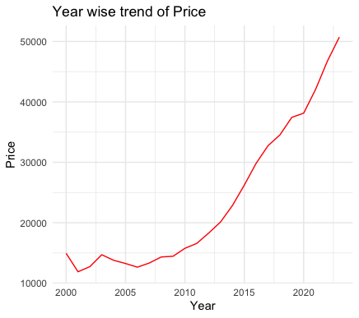
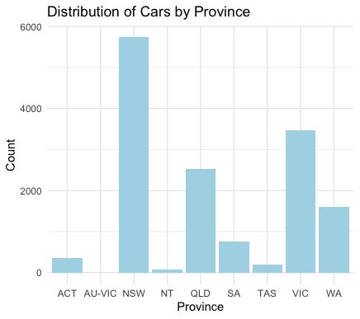
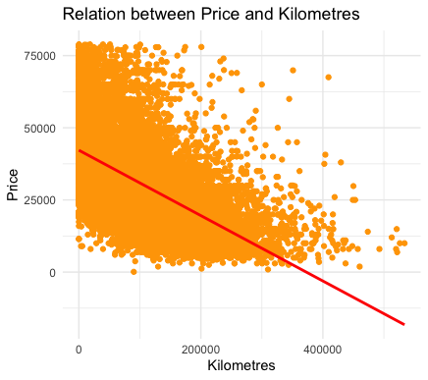
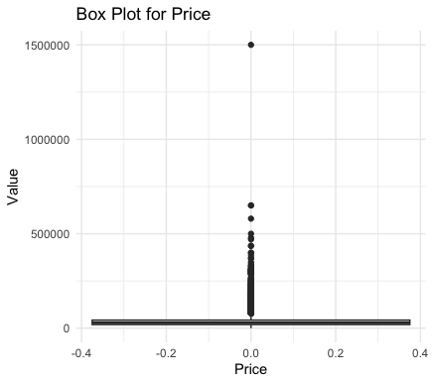
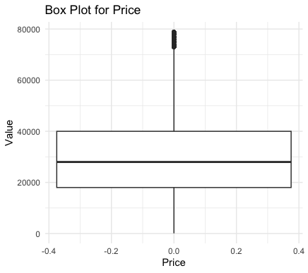
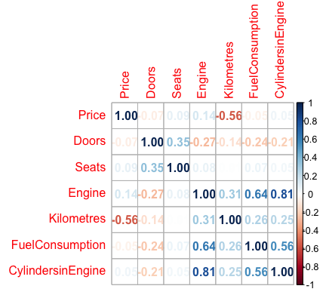
Exploratory Data Analysis

Slide 5
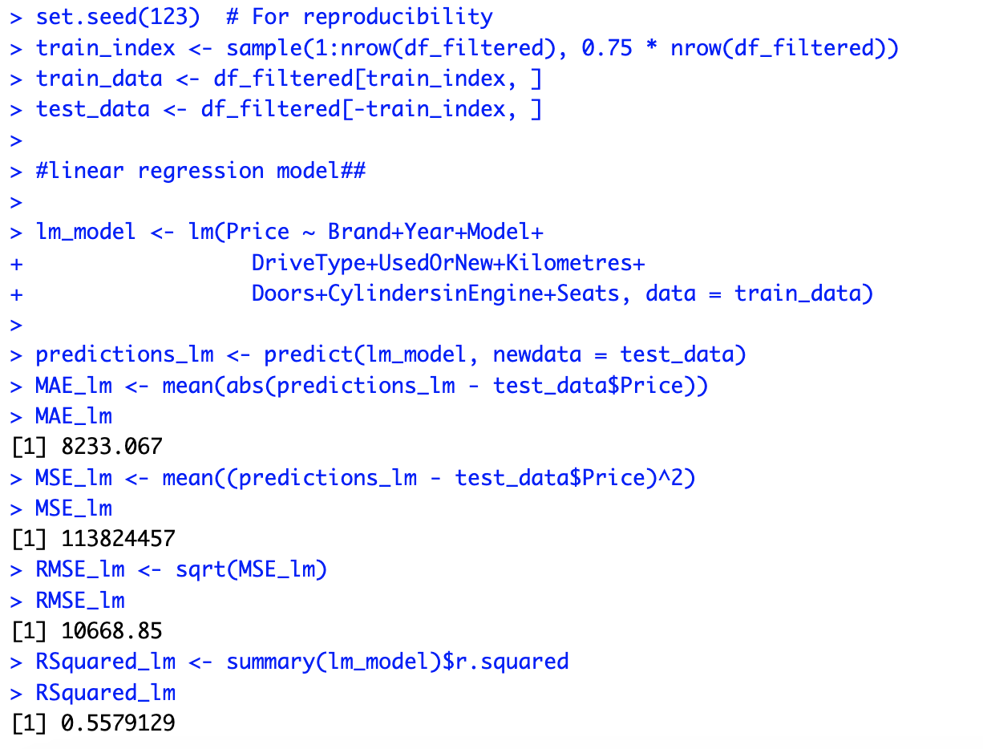
Linear Regression Model
Linear regression is a suitable choice as the relationship between predictor variables and the target variable is expected to be approximately linear, and interpretability and simplicity are important considerations for the analysis.
Using regsubsets we have identified variables Brand, Year, Model, DriveType, UsedOrNew, Kilometres, Doors, Cylinders in Engine and Seats as important variables that influence the price

Slide 6
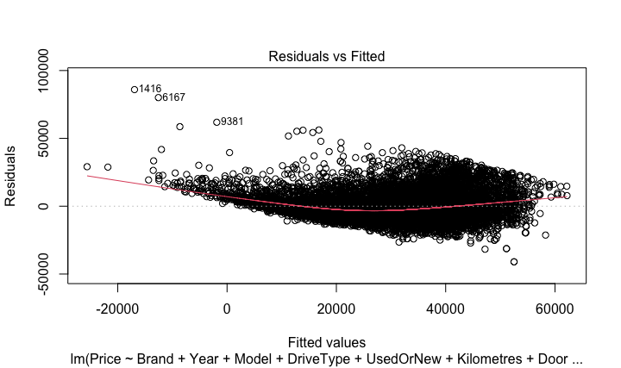
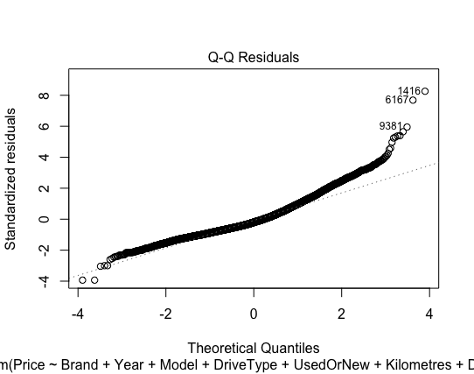
Regression Diagnostics
The plot shows residuals versus fitted values. The curved pattern and widening spread of residuals indicate potential non-linearity.
The Q-Q plot shows that while most residuals follow the normal distribution, deviations in the tails suggest the presence of outliers and some departures from normality

Slide 7
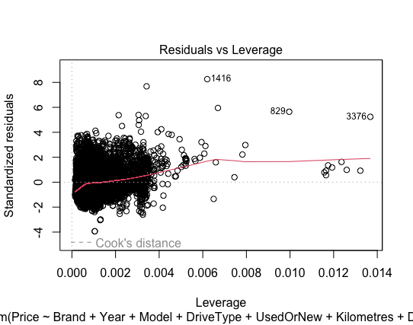
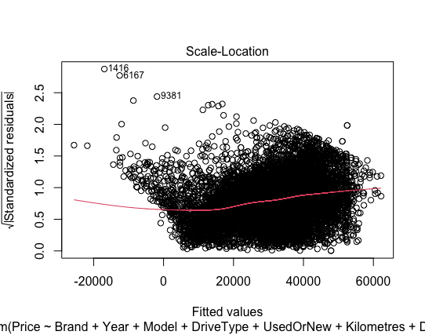
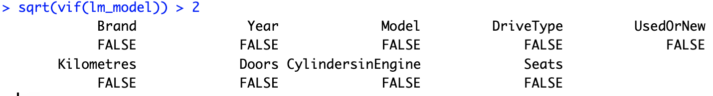
Regression Diagnostics
The Residuals vs Leverage plot highlights a few influential data points with high leverage and large residuals, indicating they have a significant impact on the model.
The Scale-Location plot shows a slight trend and increasing spread of residuals, suggesting potential heteroscedasticity in the model.
Evaluating multi-collinearity

Slide 8
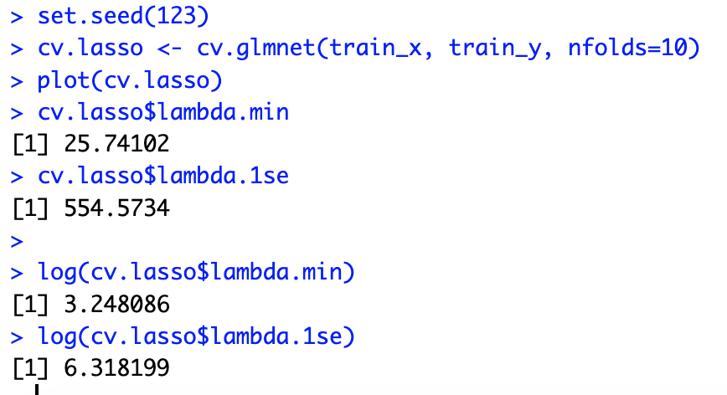
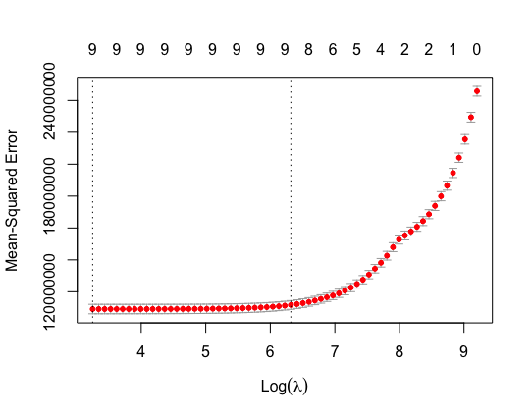
Lasso Regression Technique
Lasso and Ridge regression techniques are powerful tools for building predictive models, especially in situations where there are many predictors, multicollinearity is present, or overfitting needs to be controlled. They offer a balance between simplicity, interpretability, and predictive performance.

Slide 9
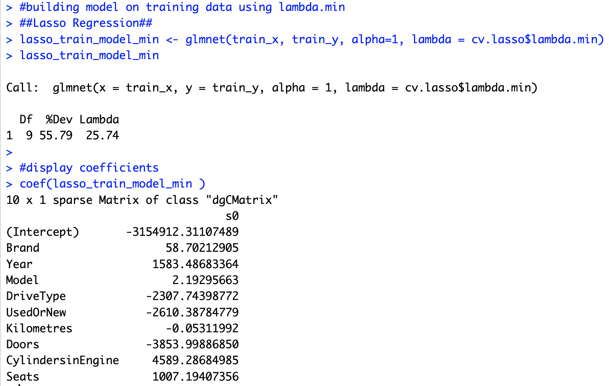
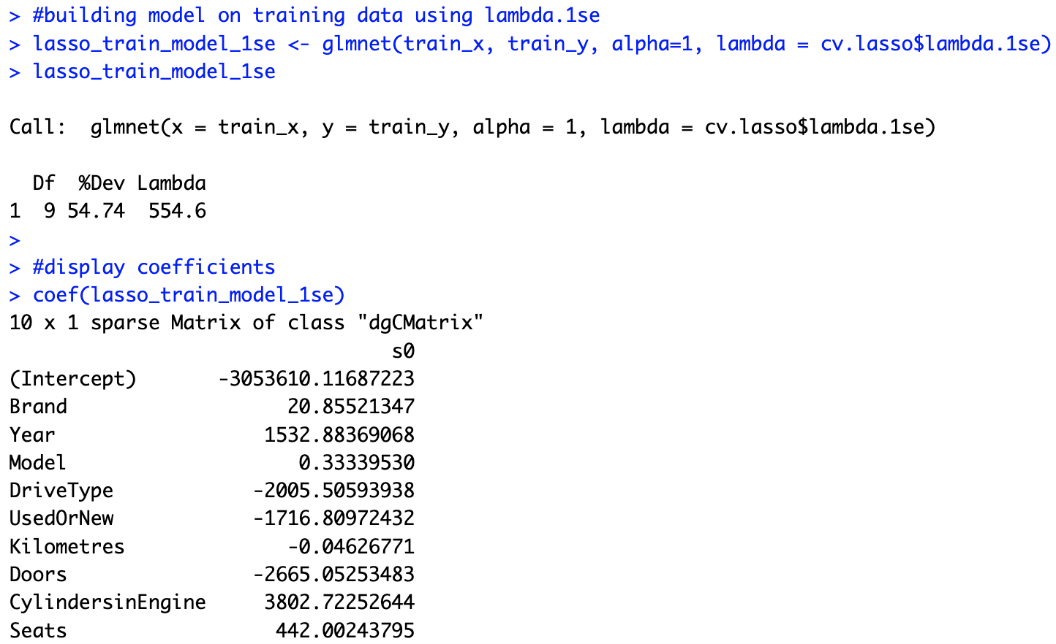
Lasso Regression
Predicting based on train and test data using lambda.1se & lambda.min
The Lasso regression model with lambda.min (minimum lambda selected by cross-validation) shows a RMSE of around 10,571.45 on the test dataset.
The Lasso regression model with lambda.1se (lambda that gives a model with the most significant predictors) shows a RMSE of around 10,833.11 on the test dataset.

Slide 10
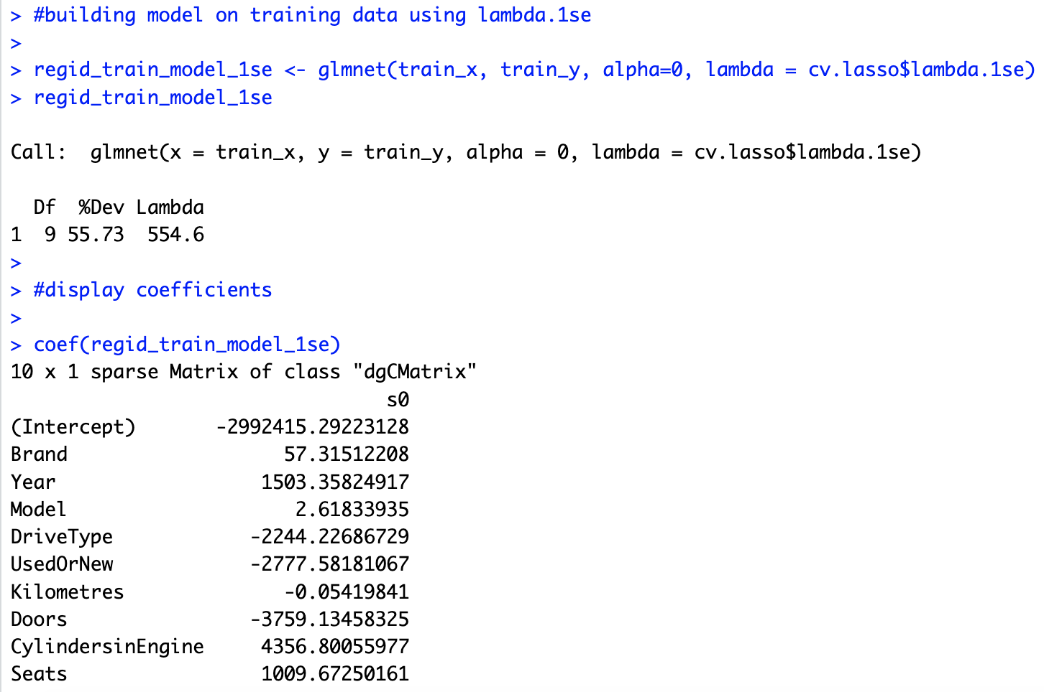
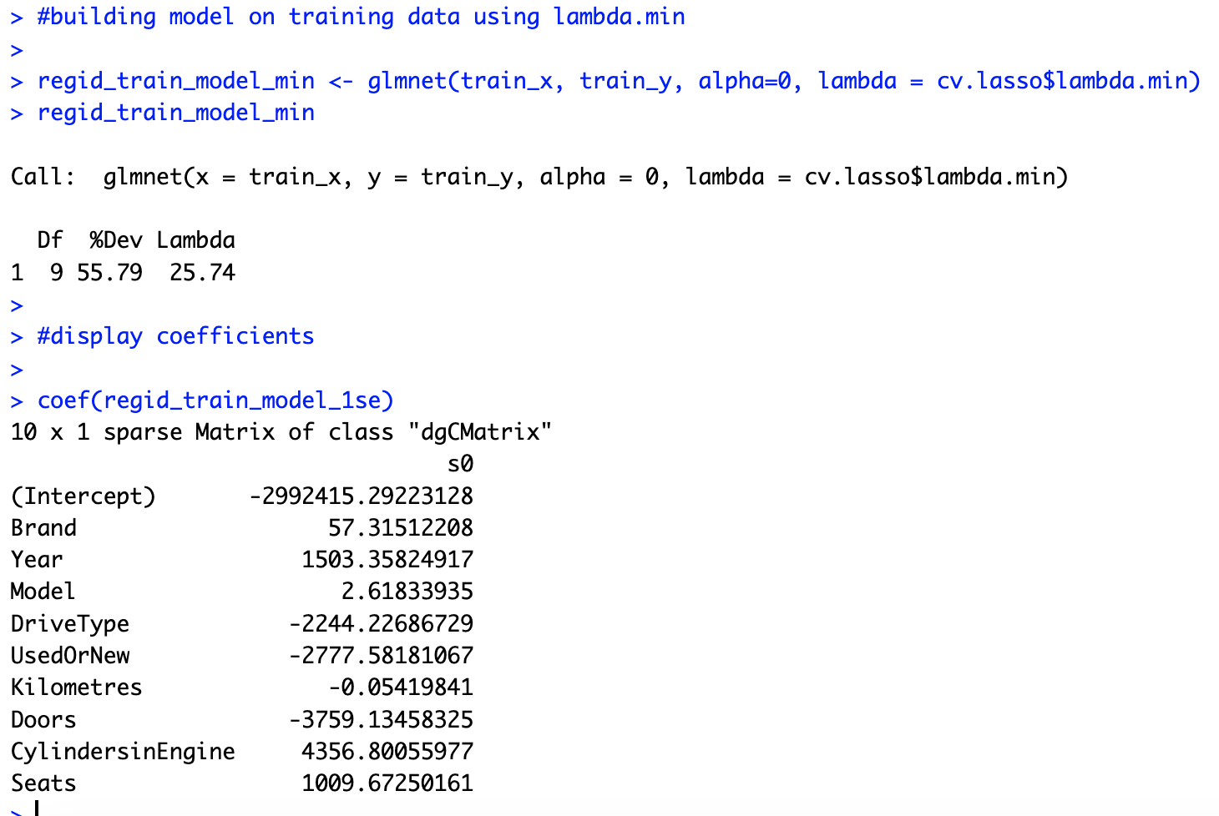
Ridge Regression
Predicting based on train and test data using lambda.1se & lambda.min
The Ridge regression model with lambda.min (minimum lambda selected by cross-validation) shows a RMSE of around 10,669.45 on the test dataset.
The Ridge regression model with lambda.1se (lambda that gives a model with the most significant predictors) shows a RMSE of around 10,688.48 on the test dataset.

Slide 11
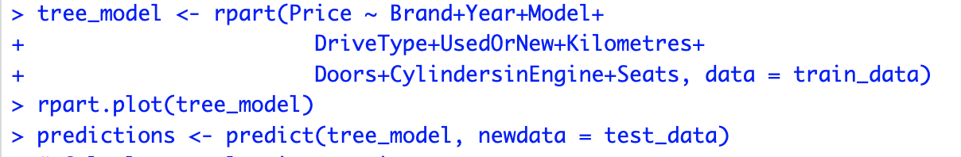
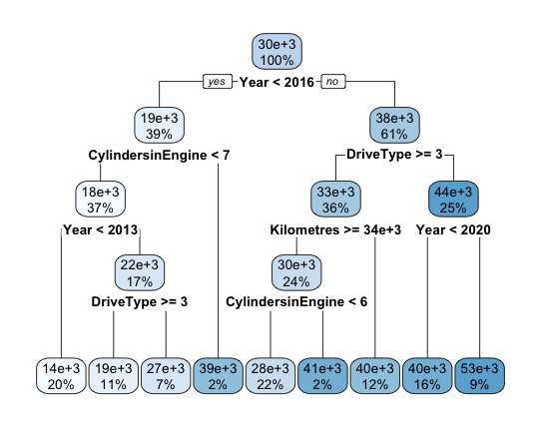
Decision Tree Regressor
Decision trees are interpretable and provide insights into the relationships between features and the target variable. The decision tree diagram visualizes how different features influence the predicted car prices.
The calculated evaluation metrics
Mean Absolute Error (MAE): $7924.66.
Mean Squared Error (MSE): 106770550.
Root Mean Squared Error (RMSE): $10,332.98.
R-squared (R²): 57%

Slide 12
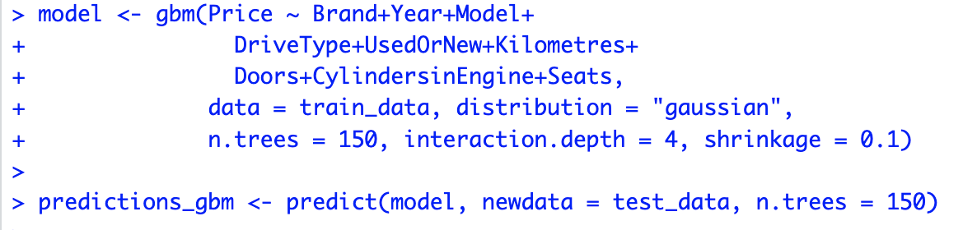
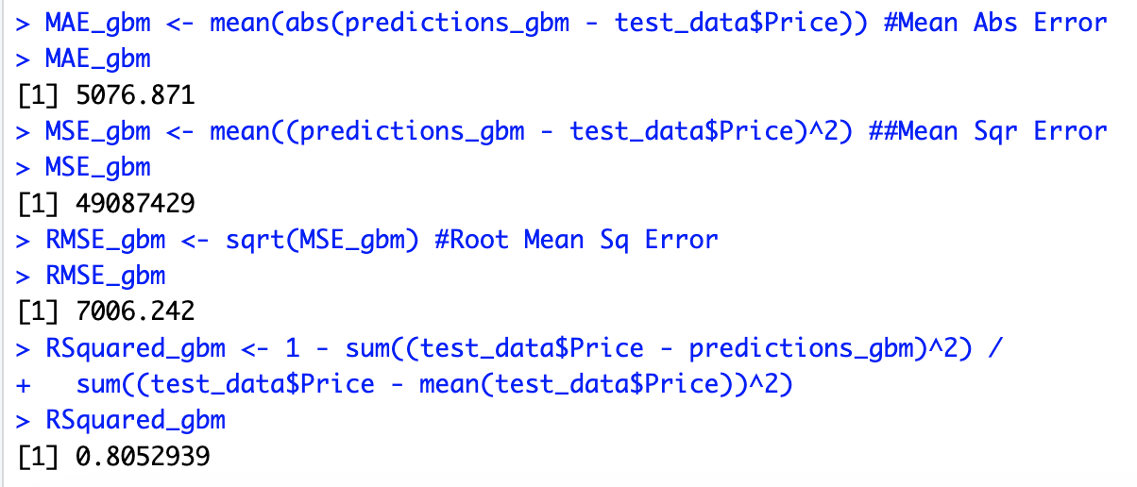
Gradient Boosting Algorithm
Due to the low R-squared value of the decision tree model, gradient boosting was employed to boost the predictive performance. Gradient boosting combines multiple weak learners (decision trees) to create a strong predictive model.
The calculated evaluation metrics
The findings suggest that the gradient boosting model performs reasonably well in predicting car prices in Australia, with an R-squared value of approximately 0.80, indicating that around 80% of the variance in car prices can be explained by the features included in the model. The RMSE value of approximately 10667.73 indicates the average magnitude of errors in the predictions.

Slide 13
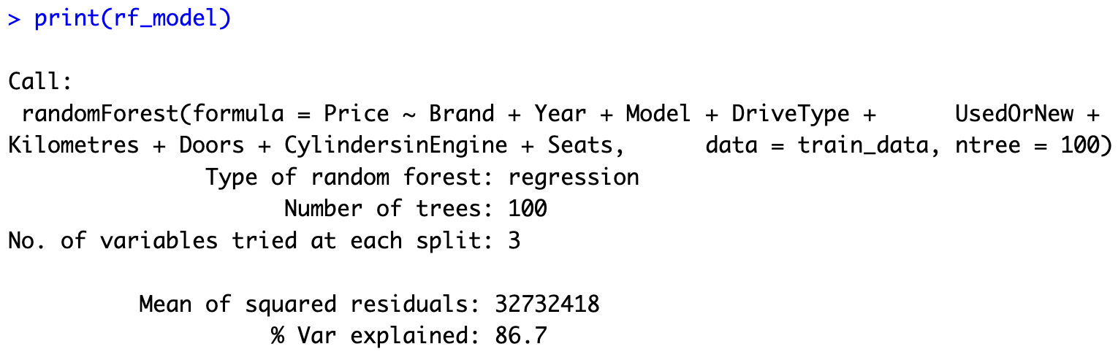
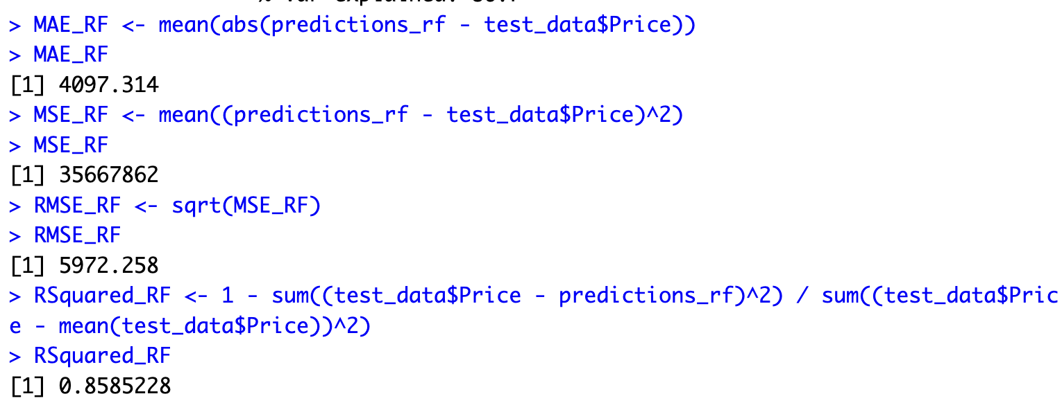
Random Forest Regressor
Random Forest Regression is a versatile and powerful machine learning technique that offers robust performance, scalability, and feature importance analysis, making it a suitable choice for predicting car prices in Australia and addressing the associated business questions.

Slide 14
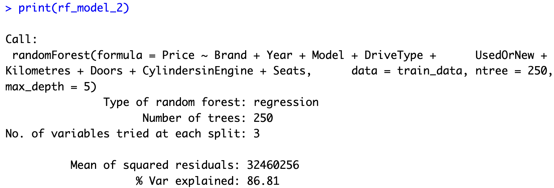
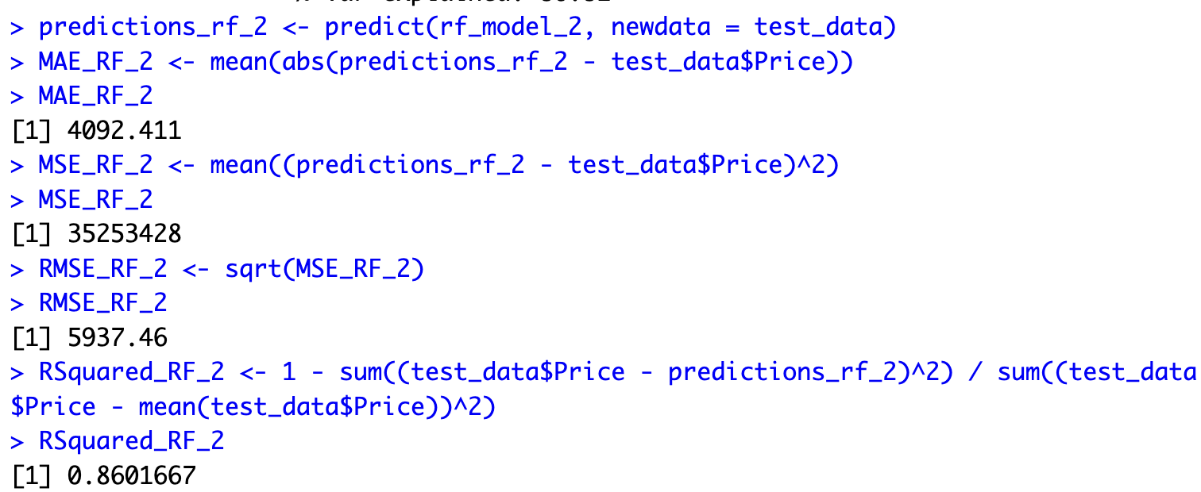
Tuning Random Forest model based on tree depth
We tune the model by changing the number of trees from 100 to 250 and depth to 5.

Slide 15
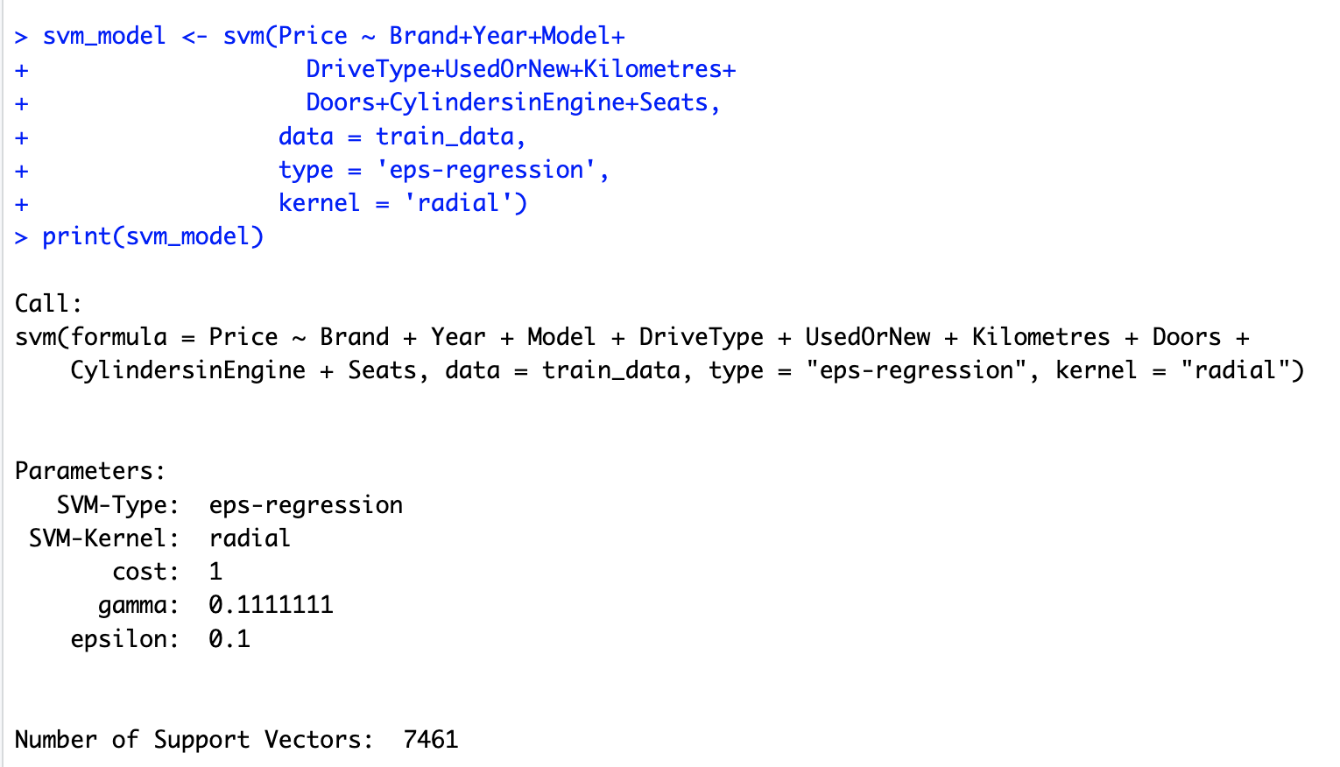
Support Vector Machine Regressor
SVMs offer a robust, flexible, and interpretable approach to regression tasks, making them well-suited for predicting car prices in Australia based on the diverse set of features provided in the dataset.
Insights & Findings :
The SVM model exhibits moderate-to-high accuracy in predicting car prices, as indicated by the evaluation metrics.
The number of support vectors (7461) indicates the importance of these data points in determining the decision boundary and making predictions
Mean Absolute Error (MAE): Approximately 4801.503
Mean Squared Error (MSE): Approximately 51,324,898
Root Mean Squared Error (RMSE): Approximately 7164.14
R-squared (RSquared): Approximately 0.7964, suggests that around 79.64% of the variance in car prices is explained by the features included in the model.

Slide 16
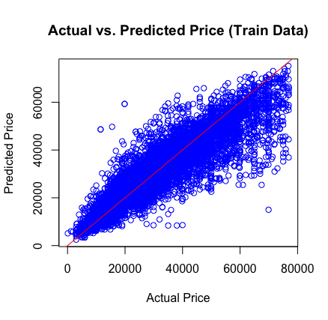
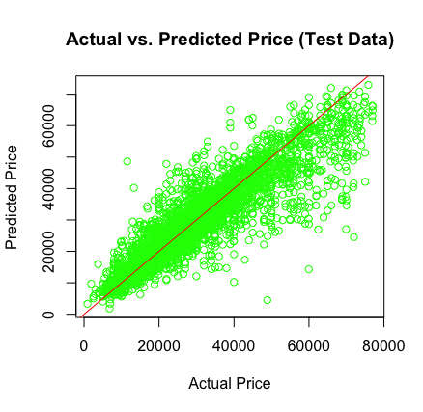
Support Vector Machine Regressor
SVM Plots

Slide 17

Conclusion
We evaluated the performance of various regression models for predicting car prices based on several features. Here's a summary of our findings:
Support Vector Machine (SVM) Regression:
The SVM model demonstrates moderate-to-high accuracy in predicting car prices.
With approximately 7461 support vectors, the model captures crucial data points influencing predictions.
Evaluation metrics:
Mean Absolute Error (MAE): Approximately $4801.503
Mean Squared Error (MSE): Approximately 51,324,898
Root Mean Squared Error (RMSE): Approximately $7164.14
R-squared (RSquared): Approximately 0.7964, suggesting that around 79.64% of the variance in car prices is explained by the features.
Other Models Comparison:
Lasso and Ridge regression models show comparable performance with SVM in terms of RMSE.
Decision Tree and Gradient Boosting models exhibit slightly higher R-squared values compared to SVM, indicating better explanatory power.
Random Forest stands out with the lowest RMSE and highest R-squared value among the evaluated models.

Slide 18

Thank You

